Slide 1
IBM University Engagement Project Submission
“Exploring the Power of Agentic AI with IBM Granite and LangFlow”

Slide 2

Project Tile- CareSense AI
AI-Powered Preventive Healthcare Assistant using IBM watsonx Orchestrate
Domain of Project – Healthcare (AI for Elderly Care & Preventive Health Monitoring)
Student Name | Recent Passport Photo | Email ID | Mobile number [WhatsApp]
Mrunal Machhindra Shinde |  | mrunalshinde2104@gmail.com | 8262024828

Slide 3
Problem Statement - CareSense AI
The Challenge
The growing elderly population faces challenges such as falls, prolonged sitting, poor posture, irregular heart rate, and delayed medical attention. Continuous health monitoring is often unavailable, leaving caregivers unaware of potential health risks until emergencies occur. Existing solutions provide fragmented health information but lack real-time, personalized health insights and preventive recommendations. There is a need for an intelligent assistant that continuously analyzes health data, identifies potential risks, and supports both elderly users and caregivers.
The Objective
Build an AI-powered Smart Healthcare Assistant that delivers personalized health monitoring, preventive recommendations, and caregiver support using IBM watsonx Orchestrate.
The solution should provide:
Personalized Health Analysis – Analyze heart rate, SpO₂, temperature, posture, sitting duration, and weight to generate health insights.
Health Knowledge Retrieval (RAG) – Retrieve trusted healthcare information, preventive care guidelines, and wellness recommendations.
Health Monitoring & Feedback – Accept health data (manual or IoT sensors) and provide instant analysis, health scores, and risk levels.
Preventive Healthcare Focus – Recommend posture correction, hydration, movement, fall prevention, and early risk detection.
Multi-Agent System
Health Data Analysis Agent – Processes and validates health readings.
Health Recommendation Agent – Generates personalized health suggestions.
Health Advisory Agent – Provides preventive healthcare guidance.
Caregiver Support Agent – Creates health reports and emergency alerts.
Visualization Dashboard – Display health score, vital signs, risk level, posture analysis, trends, and caregiver notifications.

Slide 4
Proposed Solution -
Proposed Solution: AI-Powered CareSense AI
The proposed solution is a multi-agent AI-powered Smart Healthcare Assistant built using IBM watsonx Orchestrate, watsonx.ai, Granite Models, and Retrieval-Augmented Generation (RAG) to provide personalized, real-time health monitoring and preventive healthcare recommendations for elderly users. The system addresses challenges in continuous health monitoring, early risk detection, posture analysis, and caregiver support through an intelligent, modular architecture.
At its core, the solution uses a Retrieval-Augmented Generation (RAG) pipeline to retrieve trusted healthcare knowledge from sources such as WHO guidelines, CDC recommendations, elderly healthcare documents, and uploaded medical resources. This knowledge is embedded and stored in a vector database, enabling the system to retrieve accurate health information and generate context-aware recommendations using Granite Models.
The system consists of four key AI agents:
Health Data Analysis Agent collects and analyzes health parameters such as heart rate, SpO₂, body temperature, posture, sitting duration, and fall detection data from manual inputs or future IoT sensors.
Health Recommendation Agent generates personalized preventive healthcare recommendations based on the user's health status, lifestyle, and risk level.
Health Advisory Agent retrieves reliable healthcare information using RAG and provides educational guidance, preventive care suggestions, and explanations of abnormal health readings.
Caregiver Support Agent generates health summaries, daily reports, emergency alerts, and caregiver notifications to improve elderly safety and enable timely intervention.
The solution includes a modern healthcare dashboard that visualizes vital signs, Health Score, Risk Level, posture analysis, health trends, and caregiver notifications through an intuitive and responsive user interface.
IBM watsonx Orchestrate is used to coordinate the multi-agent workflows, while watsonx.ai provides scalable AI model deployment, embeddings, and governance. Granite Models power intelligent reasoning, health analysis, summarization, and personalized recommendations.
Overall, CareSense AI delivers an end-to-end intelligent healthcare assistant that promotes preventive healthcare, supports elderly users with personalized health insights, assists caregivers through timely alerts, and provides a scalable foundation for future integration with IoT-enabled Smart Elderly Care Chair systems.

Slide 5
Technology Used
Technology Stack
IBM watsonx Orchestrate
For designing, orchestrating, and deploying the multi-agent AI healthcare assistant. It coordinates AI agents, manages workflows, and enables seamless interaction between users and intelligent healthcare services.
IBM Granite Models (e.g., granite-3.2-8b)
For natural language understanding, reasoning, health data analysis, summarization, and generating personalized preventive healthcare recommendations.
IBM watsonx.ai
For AI model deployment, prompt engineering, embeddings, Retrieval-Augmented Generation (RAG), and AI governance to ensure scalable and reliable AI services.
Retrieval-Augmented Generation (RAG)
Used to retrieve trusted healthcare information from medical guidelines, elderly care documents, and knowledge bases before generating AI responses, improving the accuracy and reliability of recommendations.
Vector Database (FAISS / ChromaDB)
Stores document embeddings and enables fast semantic search for healthcare guidelines, posture recommendations, and preventive care information used by the RAG pipeline.
IBM Cloud
Provides a secure, scalable cloud platform for deploying the AI healthcare assistant, hosting services, and supporting future integration with IoT devices and cloud databases.
HTML, CSS & JavaScript
Used to develop a responsive and modern healthcare dashboard that integrates seamlessly with the IBM watsonx Orchestrate AI assistant.
Firebase (Future Integration)
Used for real-time storage of health sensor data, synchronization across devices, and communication between the Smart Care Chair, AI assistant, and caregiver application.
ESP32 & IoT Sensors (Future Integration)
Collect real-time health parameters such as heart rate, SpO₂, body temperature, posture, sitting duration, and fall detection, which are analyzed by the AI assistant to generate personalized recommendations.

Slide 6
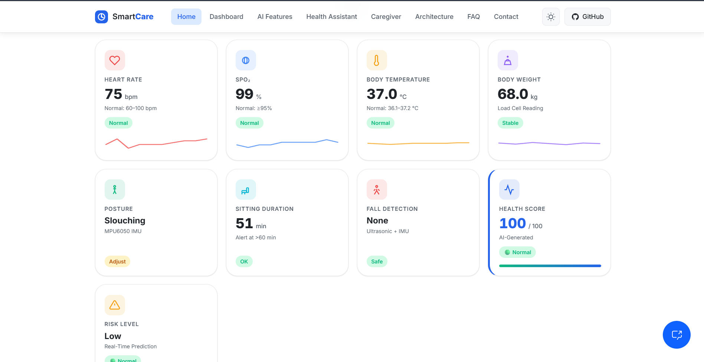

Slide 7
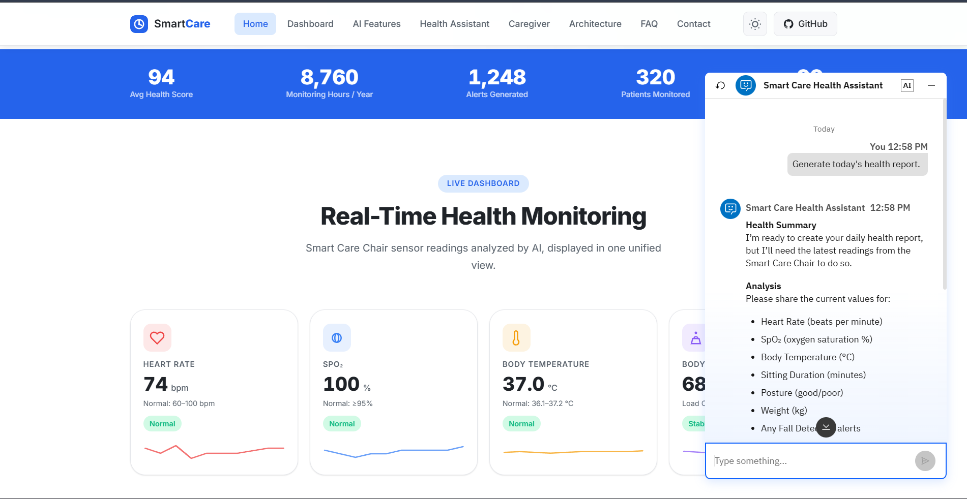

Slide 8
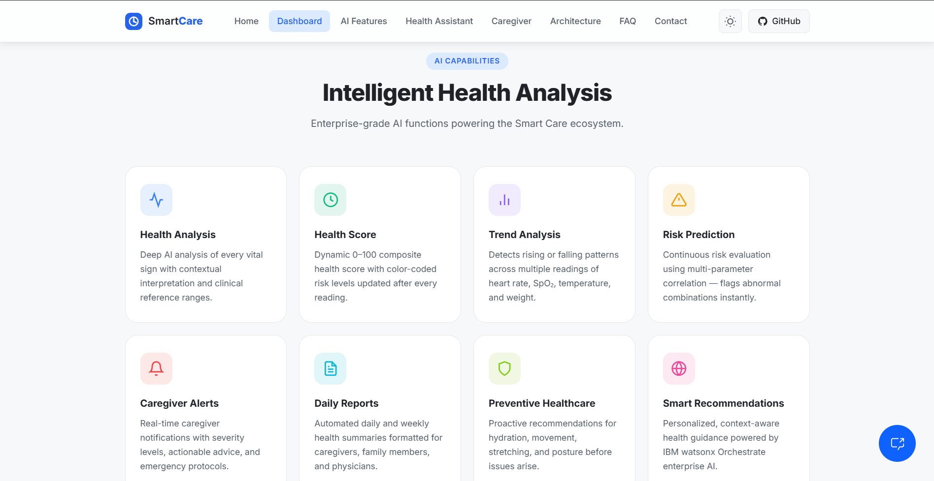

Slide 9
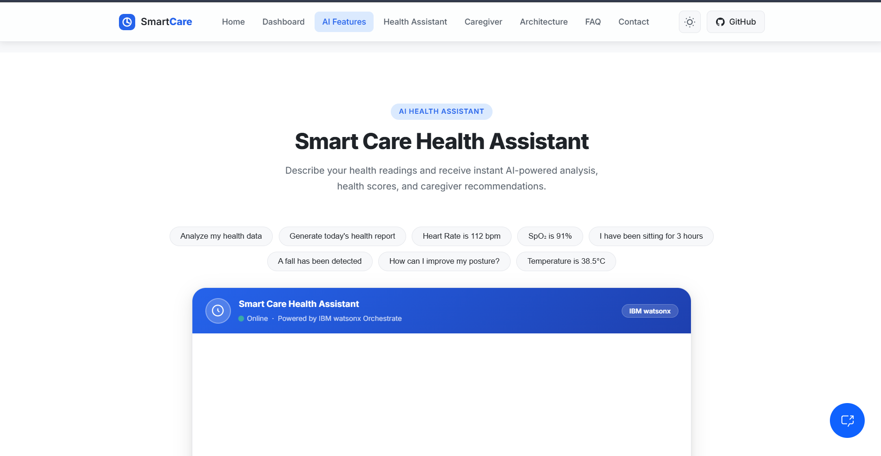

Slide 10
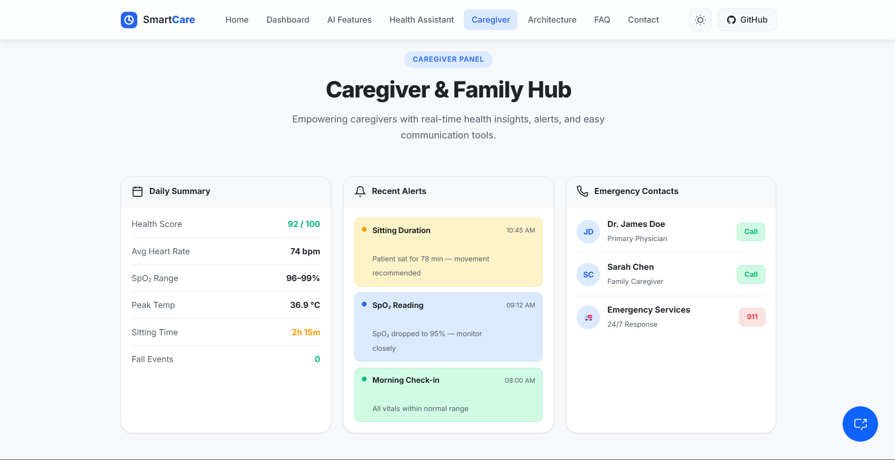

Slide 11
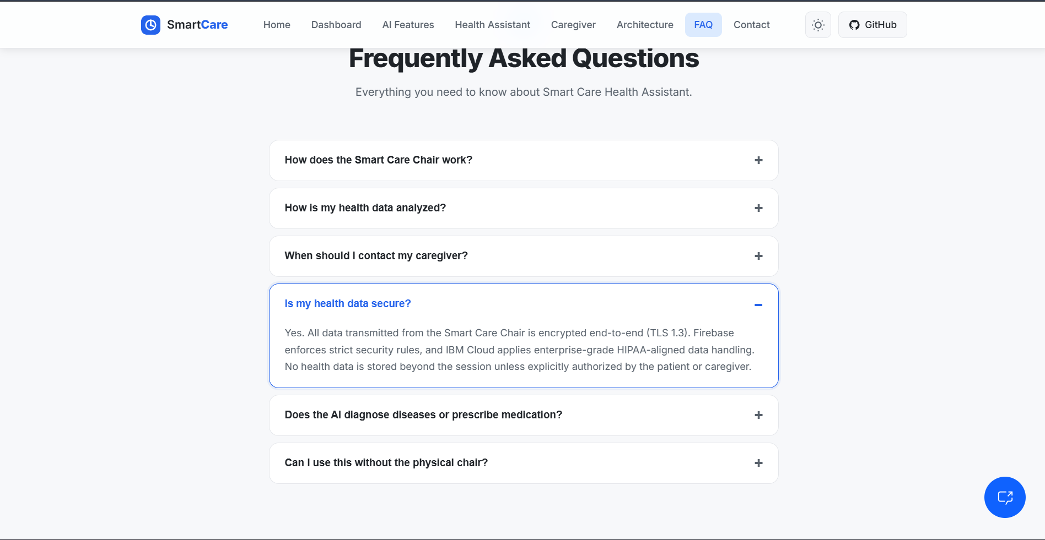

Slide 12
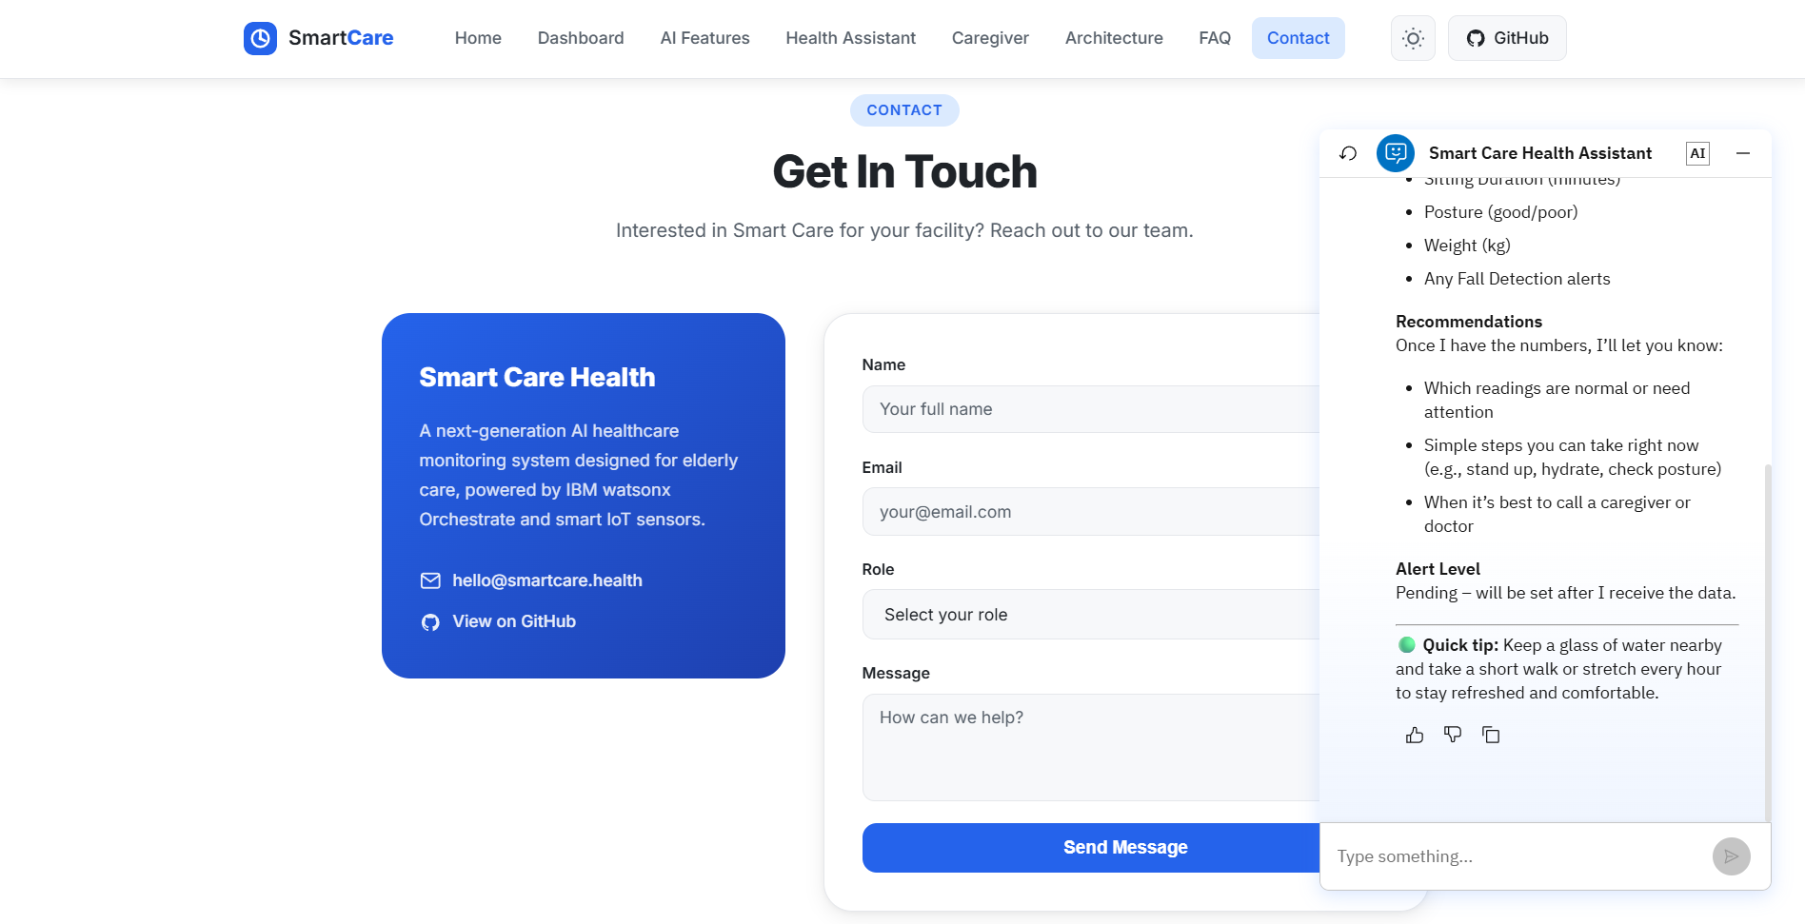

Slide 13

Role of Agentic AI in the solution
Role of Agentic AI in CareSense AI
Agentic AI enables CareSense AI to function as an intelligent, autonomous healthcare assistant rather than a simple chatbot. Using IBM watsonx Orchestrate, IBM watsonx.ai, and IBM Granite models, it coordinates multiple specialized AI agents to deliver personalized health monitoring, preventive healthcare guidance, and caregiver support.
Each agent performs a specific role—such as analyzing health data, retrieving trusted healthcare information, generating personalized recommendations, and creating caregiver alerts—while collaborating with other agents to provide accurate and context-aware responses. This multi-agent architecture ensures efficient task execution and improves decision-making.
Agentic AI understands user-specific information such as health conditions, symptoms, posture, heart rate, SpO₂, body temperature, and lifestyle patterns to generate personalized preventive healthcare recommendations. It continuously adapts its responses based on new user inputs or future IoT sensor data, enabling real-time health monitoring and early risk detection.
Additionally, the agents communicate with one another to perform health analysis, assess potential risks, generate health summaries, and provide timely caregiver notifications. This collaborative approach enhances the overall reliability and effectiveness of the system.
Overall, Agentic AI makes CareSense AI proactive, intelligent, and goal-driven, acting as a smart digital healthcare assistant that promotes preventive healthcare, supports elderly users, and assists caregivers in improving health and well-being.

Slide 14
Novelty and Uniqueness
Innovation & Uniqueness of CareSense AI
The proposed CareSense AI stands out by combining Agentic AI, IBM watsonx Orchestrate, Retrieval-Augmented Generation (RAG), and personalized healthcare intelligence into a single smart healthcare assistant.
Multi-Agent Intelligence – Instead of a single chatbot, multiple specialized AI agents collaborate to analyze health data, retrieve medical knowledge, generate personalized recommendations, and support caregivers.
RAG-Based Healthcare Knowledge – Combines real-time retrieval of trusted healthcare guidelines with AI-generated responses, ensuring accurate, reliable, and context-aware health recommendations.
Personalized Health Monitoring – Tailors health insights and preventive recommendations based on user symptoms, health conditions, posture, vital signs, and lifestyle patterns.
Real-Time Health Analysis – Continuously adapts recommendations based on new user inputs and future IoT sensor data, enabling proactive health monitoring and early risk detection.
Preventive Healthcare Focus – Goes beyond answering health-related questions by promoting posture correction, movement reminders, fall prevention, and healthy lifestyle recommendations.
Caregiver Support System – Generates health summaries, risk assessments, and timely alerts to assist caregivers in monitoring elderly users more effectively.
Scalable & Enterprise-Ready – Built using IBM watsonx Orchestrate, IBM watsonx.ai, and IBM Granite Models, providing a secure, scalable, and enterprise-grade AI healthcare solution.
This makes CareSense AI a proactive, intelligent, and personalized digital healthcare assistant rather than just a conventional medical chatbot, providing continuous health monitoring, preventive healthcare guidance, and caregiver support for improved elderly well-being.

Slide 15
Git Hub Link
–https://github.com/mrunalshinde2104/CareSense-AI
·
·
·

Slide 16
Future Scope
Future Scope
Wearable & Health Device Integration Integration with smartwatches and fitness trackers for real-time monitoring of heart rate, steps, calories, and sleep data to provide personalized recommendations.
AI Voice Assistant & Multilingual Support Voice-based interaction and multiple language support to improve accessibility and provide a user-friendly healthcare experience.
Predictive Health Analytics AI-based health trend analysis for early risk detection and preventive suggestions.
Personalized AI Health Coach Continuous AI guidance for diet, fitness, and lifestyle improvement based on user progress.
·
·
·

Slide 17
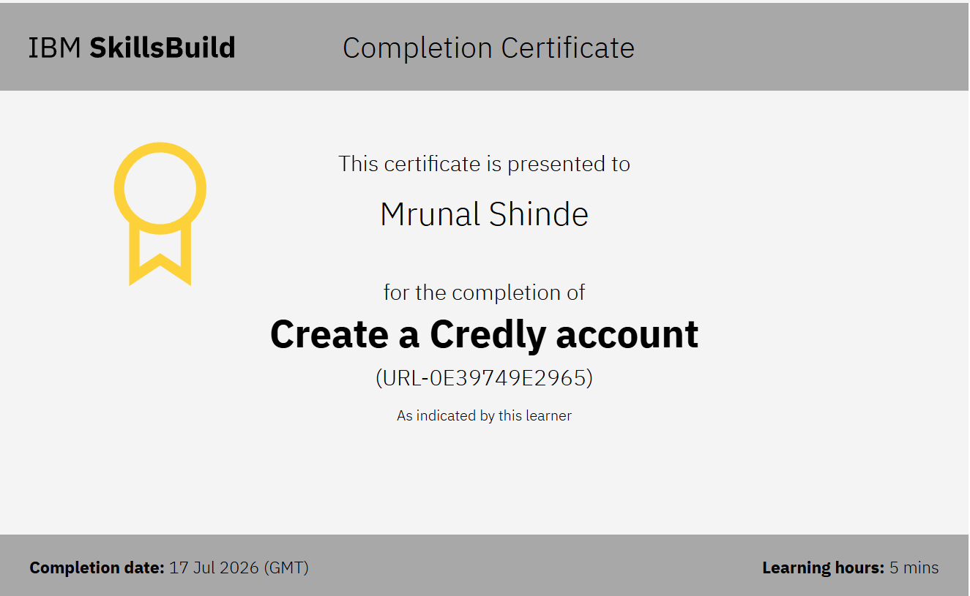
Certificates Earned:

Slide 18
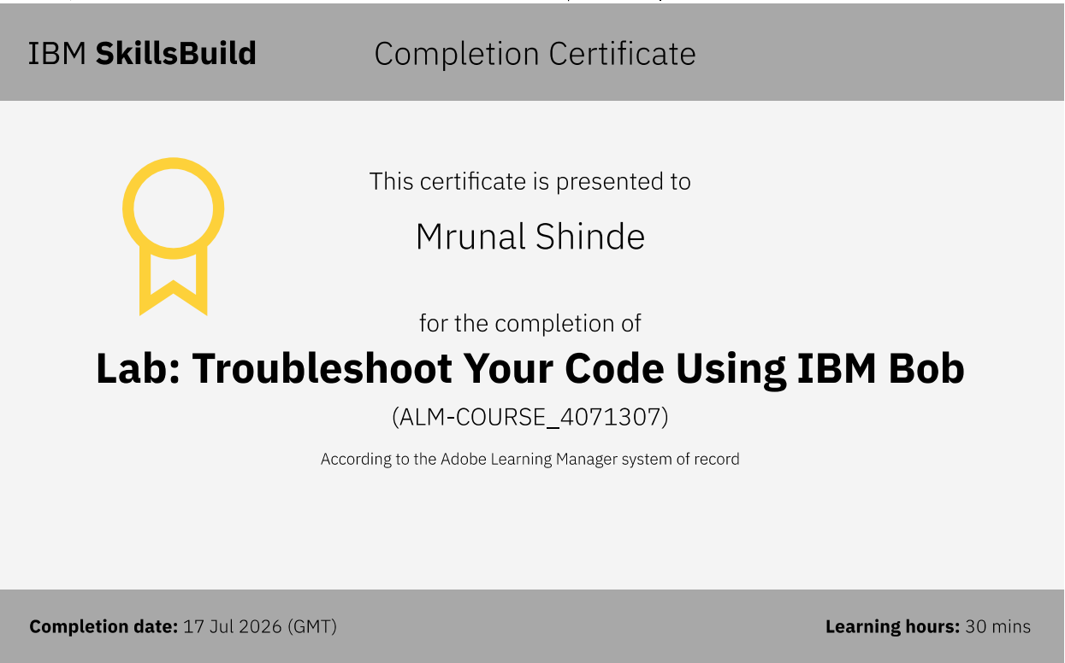
Certificates Earned:​

Slide 19


